Slide 1

Student Result Management System

Slide 2

GROUP MEMBERS AND FACULTY MEMBERS
Presented by:
Anirudra Chakrabortty
Pritam Majumder
Prolay Ghosh
Shilpi Ghosh
Guided by:
Pinaki Banerjee
Guided by:
Debaditya Raychaudhuri
Abhishek Nandi

Slide 3
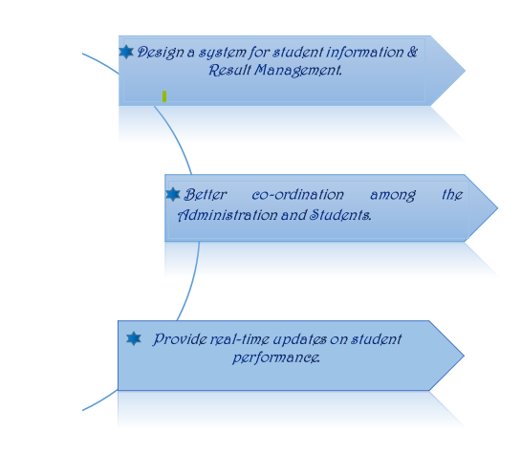
PROJECT AIMS AND OBJECTIVES

Slide 4

OPERATION ENVIRONMENT
Processor | Intel Core Processor 1.6GHz or better than that.
Operating System | Windows 7, Windows 8, Windows 10, Windows 11
Memory | 2 GB RAM or more than that
Hard disk space | 1TB.
Database | My SQL

Slide 5
SOFTWARE TOOLS USED
HTML
CSS
PHP
PHPMyAdmin
MYSQL
JAVA SCRIPT

Slide 6
FUTURE SCOPE & ENHANCEMENTS
In future we would like to keep working on this project and make new additions to provide users with more advanced features and more detailed information. We have set our sights on the following additions in future:-
1. Forget Password for admin and user.
2. More beneficial notes on Different coding languages.
3. It would be available on a global platform where anyone throughout the globe would be able to use this service for free.
4. More new and updated different kinds of coding languages will be added.

Slide 7
Various tables in Database
Admin
It stores admin details.
Classes
It stores Year and Semester details.

Slide 8
Various table in Database
Subjects
It stores all types and name of Subjects.
Students
It stores Students details and name.
Result
It stores the result of students.
Subject
combinaton
It stores subject_combination of different semester.

Slide 9
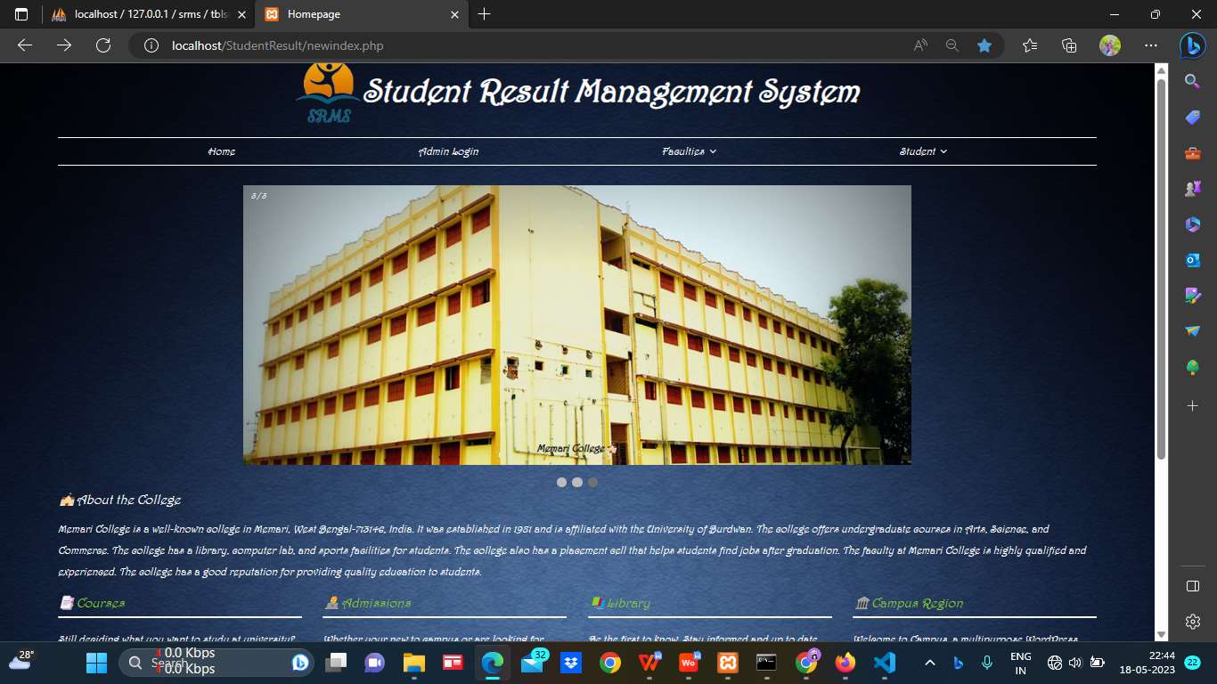
HOMEPAGE

Slide 10
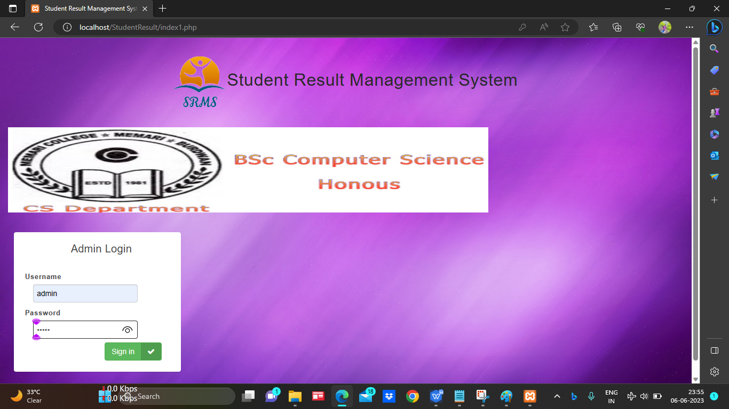
ADMIN LOGIN

Slide 11
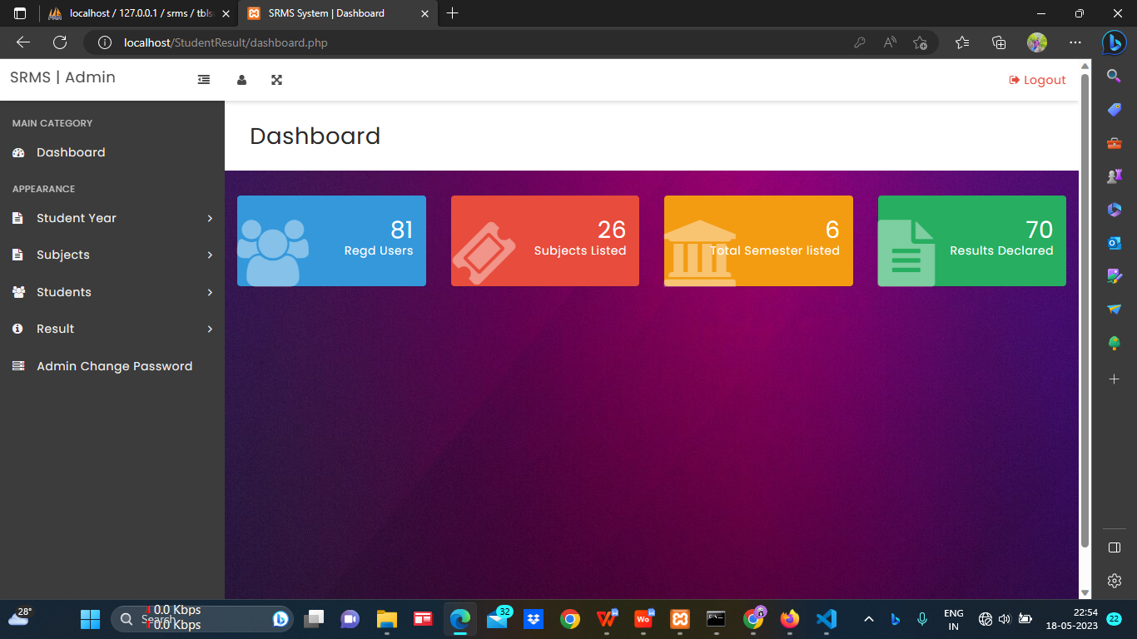
-:After Admin Login Page:- DASHBOARD PAGE

Slide 12
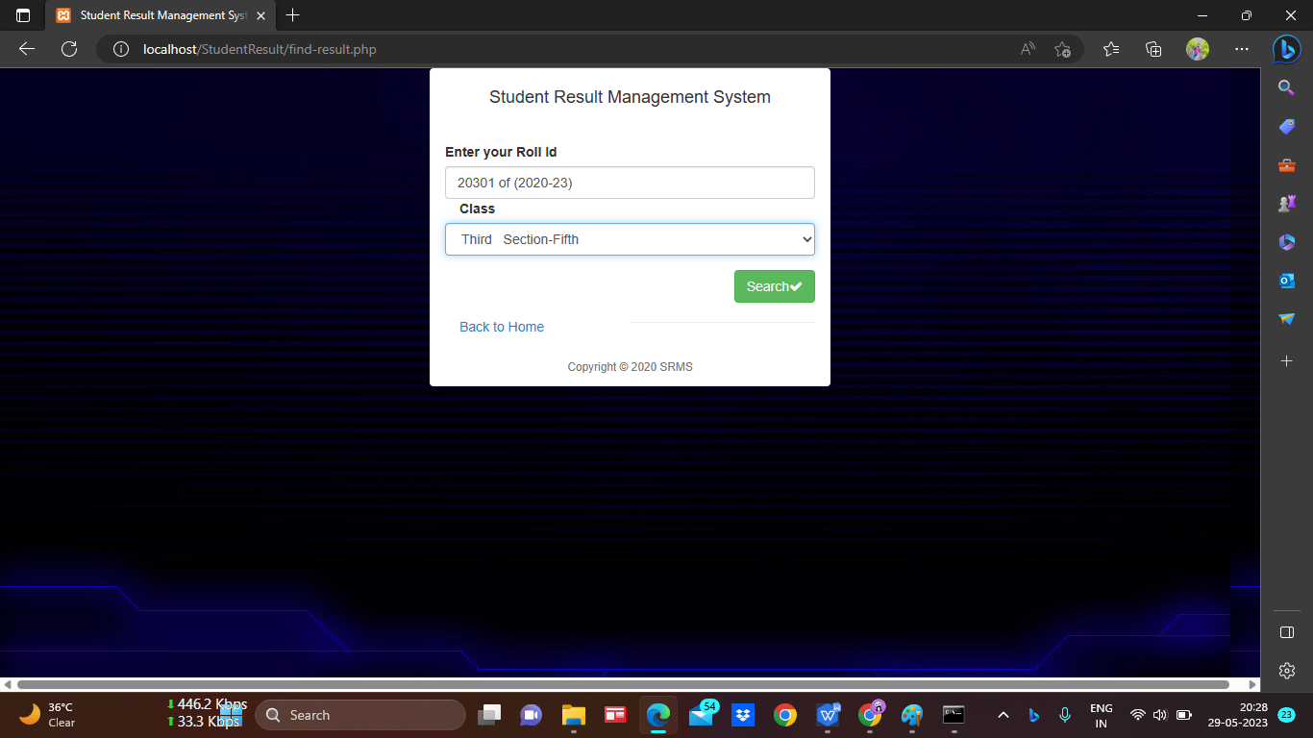
STUDENT LOGIN

Slide 13
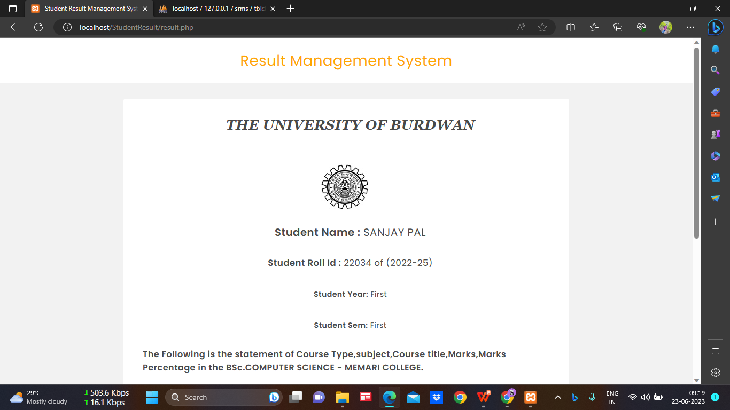
After Student Login page -:RESULT PAGE:-

Slide 14
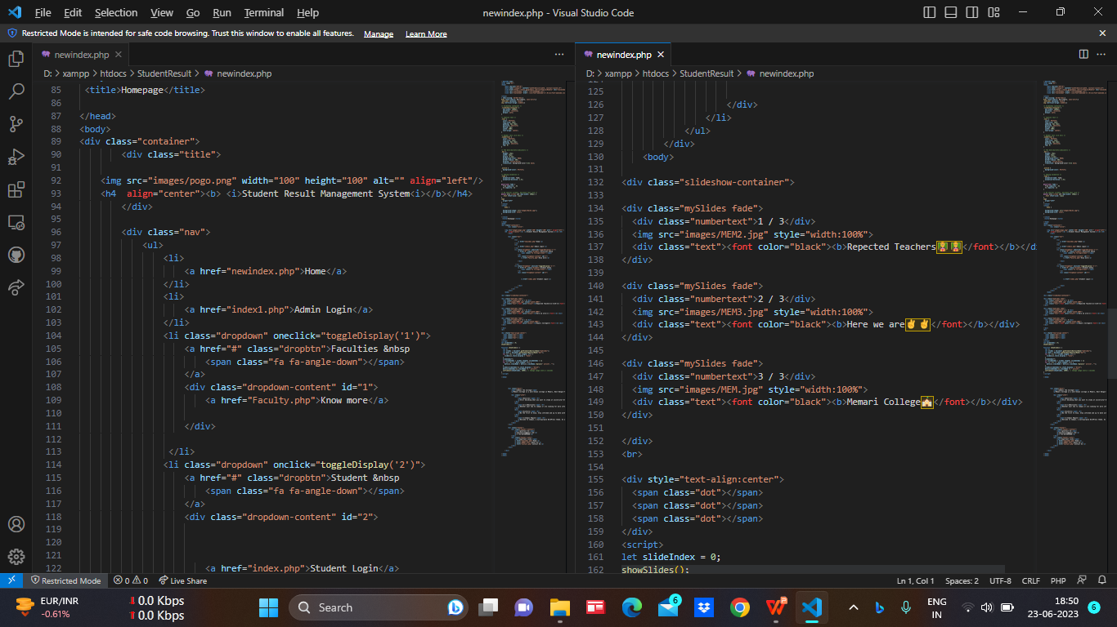
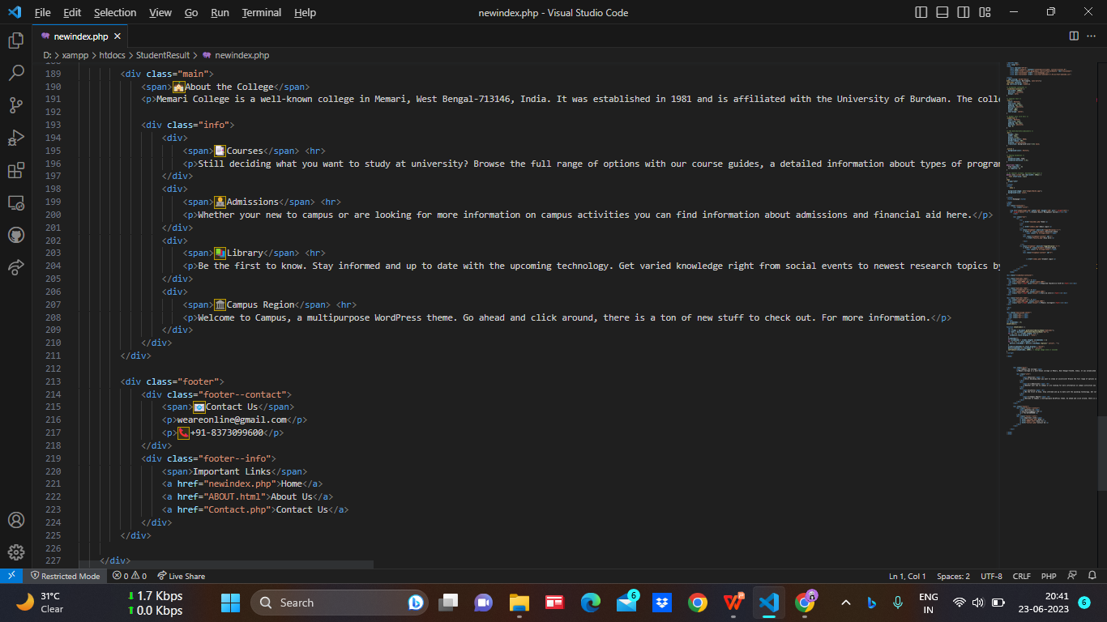
-:CODE:- MODULES
Homepage

Slide 15
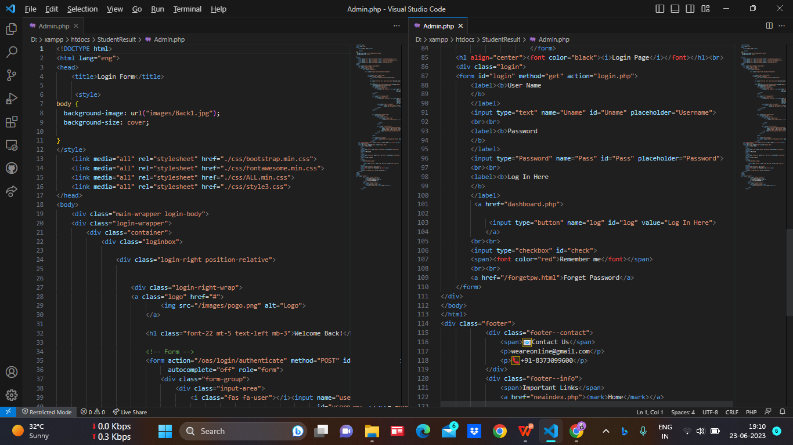
-:ADMIN MODULE:-

Slide 16
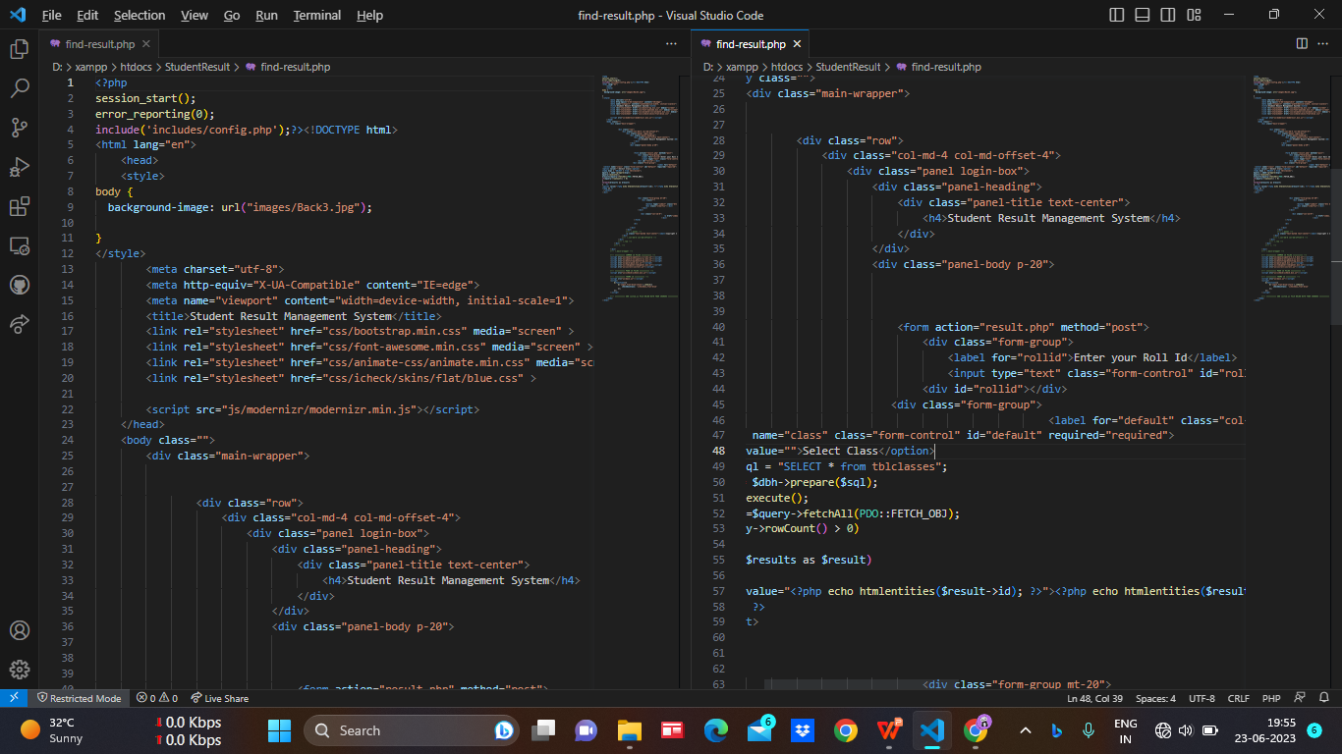
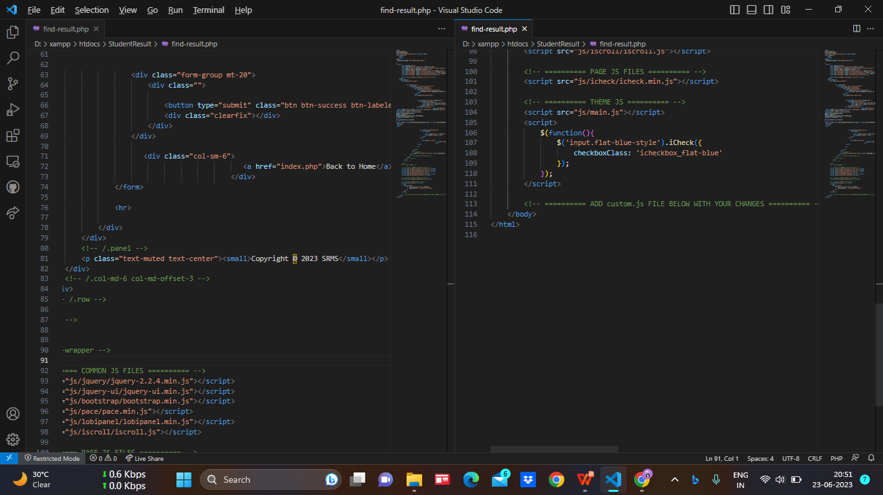
-:STUDENT MODULE:-

Slide 17
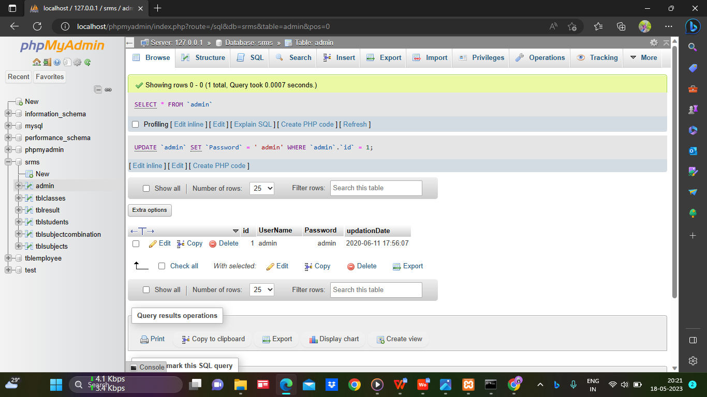
DATABASE ADMIN DATA_TABLE

Slide 18
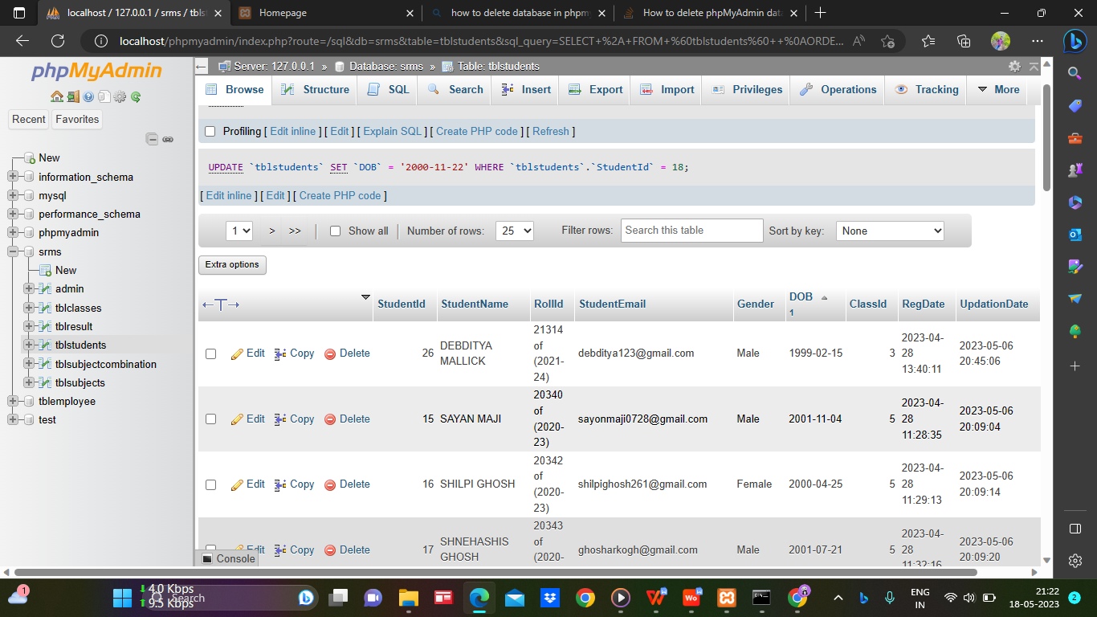
STUDENT DATA_TABLE

Slide 19
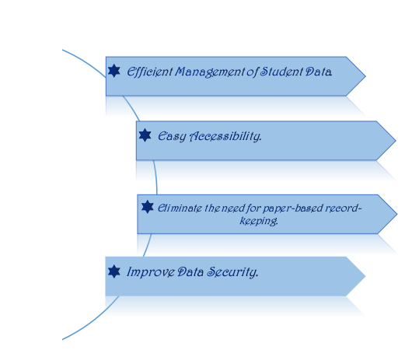
Advantages of Student Result Management System

Slide 20
Bibliography- A bibliography accomplishes few things. These include:----
https://www.w3schools.com
•https://www.slideshare.com
•https://www.scribd.com
•https://www.tutorialspoint.com
•https://www.youtube.com

Slide 21


